Slide 1



The Three Breakthroughs That have Finally Brough AI On The World
The Beauty and Joy of Computing Lecture #23 Limits of Computing
2014-11-24
UC Berkeley EECS Lecturer Gerald Friedland
http://www.wired.com/2014/10/future-of-artificial-intelligence/

Slide 2
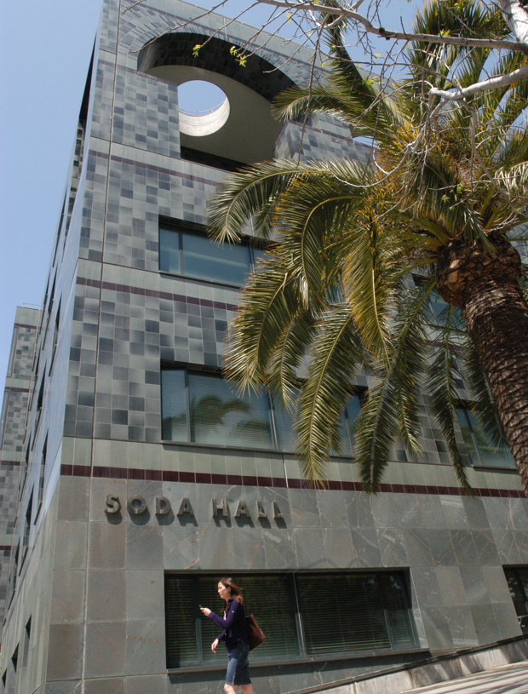
Computer Science … A UCB view
www.eecs.berkeley.edu/Research/Areas/
CS department research areas:
Artificial Intelligence
Biosystems & Computational Biology
Database Management Systems
Graphics
Human-Computer Interaction
Networking
Programming Systems
Scientific Computing
Security
Systems
Theory
Complexity theory
…

Slide 3
Let’s revisit algorithm complexity
www.csprinciples.org/docs/APCSPrinciplesBigIdeas20110204.pdf
Problems that…
are tractable with efficient solutions in reasonable time
are intractable
are solvable approximately, not optimally
have no known efficient solution
are not solvable

Slide 4
Tractable with efficient sols in real time
Recall our algorithm complexity lecture, we’ve got several common orders of growth
Constant
Logarithmic
Linear
Quadratic
Cubic
Exponential
Order of growth is polynomial in the size of the problem
E.g.,
Searching for an item in a collection
Sorting a collection
Finding if two numbers in a collection are same
These problems are called being “in P” (for polynomial)

Slide 5
Intractable problems
en.wikipedia.org/wiki/Intractability_(complexity)#Intractability
Problems that can be solved, but not solved fast enough
This includes exponential problems
E.g., f(n) = 2^{n}
as in the image to the right
This also includes poly-time algorithm with a huge exponent
E.g, f(n) = n¹⁰
Only solve for small n
Imagine a program that calculated something important at each of the bottom circles. This tree has height n,
but there are 2^{n} bottom circles!

Slide 6
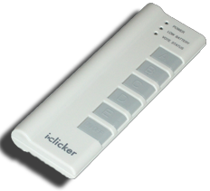
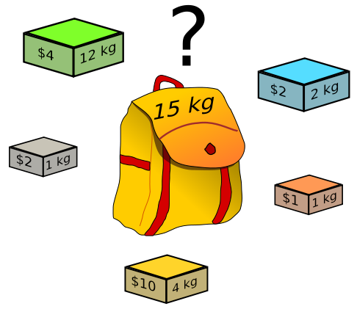
Peer Instruction
What’s the most you
can put in your
knapsack?
$10
$15
$33
$36
$40
Knapsack Problem You have a backpack with a weight limit (here 15kg), which boxes (with weights and values) should be taken to maximize value? (any # of each box is available)
Notes:
Taking a greedy approach of max $/kg the gold $10/4 = 2.5 is the most. Max out on that yields $30, with 3 kb left (15-12). The next most valuable box is the silver $2/1 = 2 box. Conveniently we fit exactly 3 boxes, for an additional $6, so $36.

Slide 7
Solvable approximately, not optimally in reas time
en.wikipedia.org/wiki/Knapsack_problem
A problem might have an optimal solution that cannot be solved in reasonable time
BUT if you don’t need to know the perfect solution, there might exist algorithms which could give pretty good answers in reasonable time
Knapsack Problem You have a backpack with a weight limit (here 15kg), which boxes (with weights and values) should be taken to maximize value?

Slide 8
Have no known efficient solution
en.wikipedia.org/wiki/P_%3D_NP_problem
Solving one of them would solve an entire class of them!
We can transform one to another, i.e., reduce
A problem P is “hard” for a class C if every element of C can be “reduced” to P
If you’re “in NP” and “NP-hard”, then you’re “NP-complete”
-2
-3
15
If you guess an answer, can I verify it in polynomial time?
Called being “in NP”
Non-deterministic (the “guess” part) Polynomial
14
7
-10
Subset Sum Problem Are there a handful of these numbers (at least 1) that add together to get 0?

Slide 9
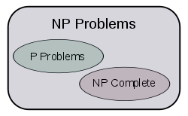
The fundamental question. Is P = NP?
en.wikipedia.org/wiki/P_%3D_NP_problem
This is THE major unsolved problem in Computer Science!
One of 7 “millennium prizes” w/a $1M reward
All it would take is solving ONE problem in the NP-complete set in polynomial time!!
Huge ramifications for cryptography, others
If P ≠NP, then
Other NP-Complete
Traveling salesman who needs most efficient route to visit all cities and return home

Slide 10
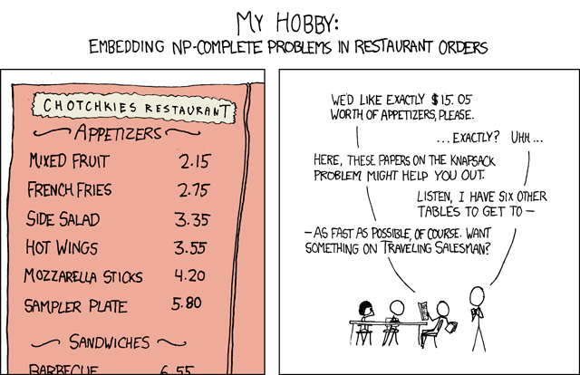
imgs.xkcd.com/comics/np_complete.png

Slide 11
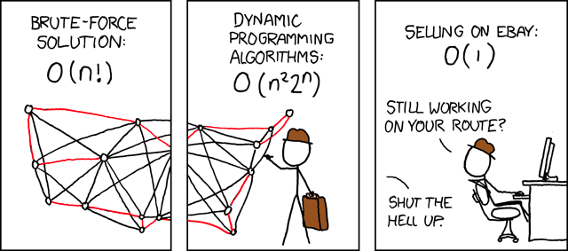
imgs.xkcd.com/comics/travelling_salesman_problem.png

Slide 12
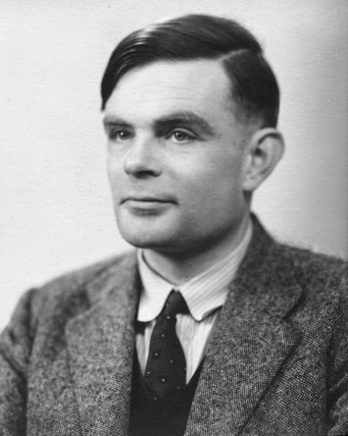
Problems NOT solvable
www.cgl.uwaterloo.ca/~csk/halt/
Decision problems answer YES or NO for an infinite # of inputs
E.g., is N prime?
E.g., is sentence S grammatically correct?
An algorithm is a solution if it correctly answers YES/NO in a finite amount of time
A problem is decidable if it has a solution
Alan Turing He asked: “Are all problems decidable?”
(people used to believe this was true)
Turing proved it wasn’t for CS!

Slide 13
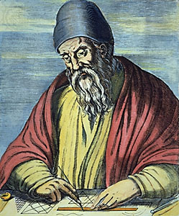
Review: Proof by Contradiction
Infinitely Many Primes?
Assume the contrary, then prove that it’s impossible
Only a finite set of primes, numbered p₁, p₂, …, p_{n}
Consider q=(p₁ • p₂ • … • p_{n})+1
Dividing q by p_{i} has remainder 1
q either prime or composite
If prime, q is not in the set
If composite, since no p_{i} divides q, there must be another p that does that is not in the set.
So there’s infinitely many primes
Euclid www.hisschemoller.com/wp-content/uploads/2011/01/euclides.jpg

Slide 14
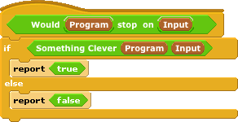

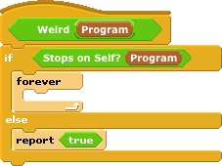

Turing’s proof : The Halting Problem
Given a program and some input, will that program eventually stop? (or will it loop)
Assume we could write it, then let’s prove a contradiction
1. write Stops on Self?
2. Write Weird
3. Call Weird on itself
Notes:
Explain proof by contradiction (infinitely many primes)

Slide 15
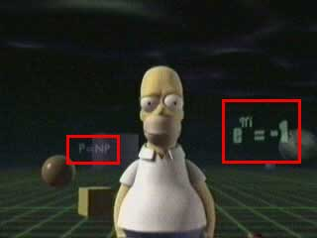
Conclusion
Complexity theory important part of CS
If given a hard problem, rather than try to solve it yourself, see if others have tried similar problems
If you don’t need an exact solution, many approximation algorithms help
Some not solvable!
P=NP question even made its way into popular culture, here shown in the Simpsons 3D episode!

